Slide 1

Bank Loan Default Risk Analysis

Slide 2

Introduction
This case study aims to give an idea about applying EDA in real business scenario. In this case study we will develop a basic understanding of risk analytics in banking and financial services and understand how data is used to minimise the risk of losing money while lending to customers.

Slide 3
Abstract of Risk factors associated with bank decision
The project Bank Loan Default Risk Analysis is about predicting how much amount of loan should be disbursed based on the attributes of person’s income, property (if he is holding any).
Apart from the above said the main factors that impact are will the person be capable of repaying the loan amount or if not how much will be able to repay based on income, or will he default.
These factors which can be utilised this knowledge for its portfolio and risk assessment

Slide 4
Algorithm
An algorithm is an step by step sequential procedure which creates a structure of handling tasks or projects given
Getting Jupyter Ready
Reading and Understanding Data
Data Cleaning and Manipulation
Data Analysis
Conclusions

Slide 5
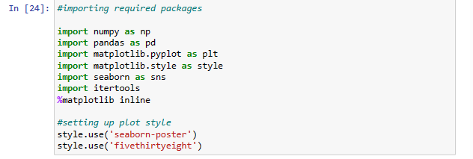
Getting jupyter Ready : Importing Libraries

Slide 6
Reading and Understanding data
Importing data and reading using pandas, understanding metrics like shape, informations, objects, if there any null values
Selecting relevant attributes from data and performing basic operations

Slide 7
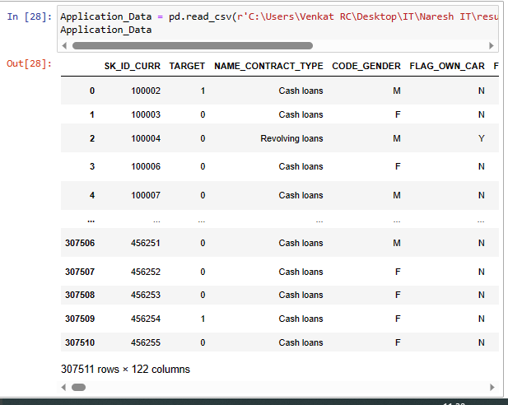
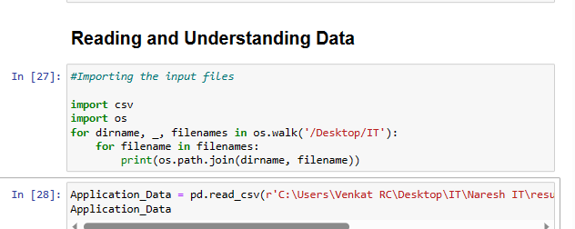
Reading and Understanding data

Slide 8
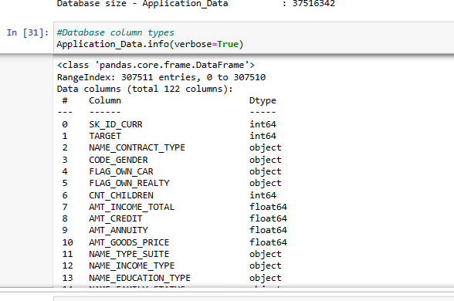
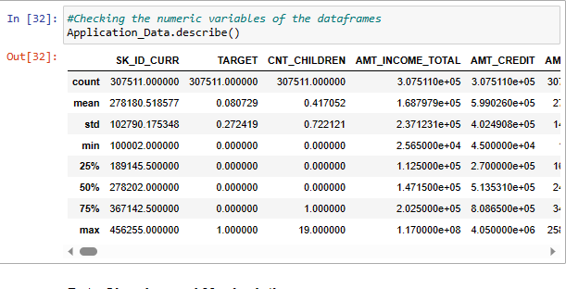

Slide 9
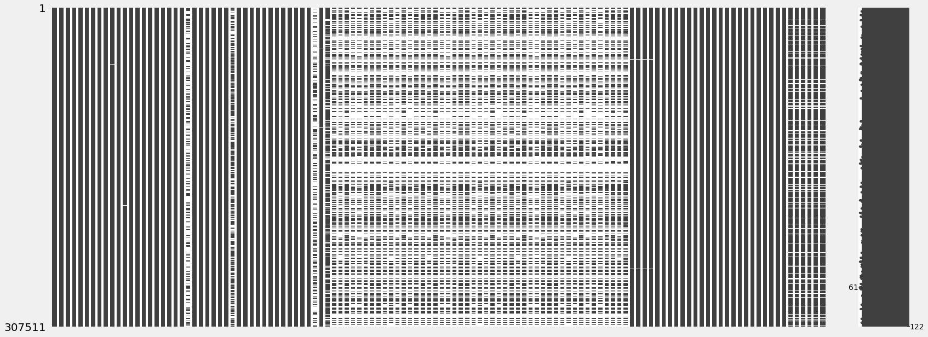
Data Cleaning and Manipulation

Slide 10
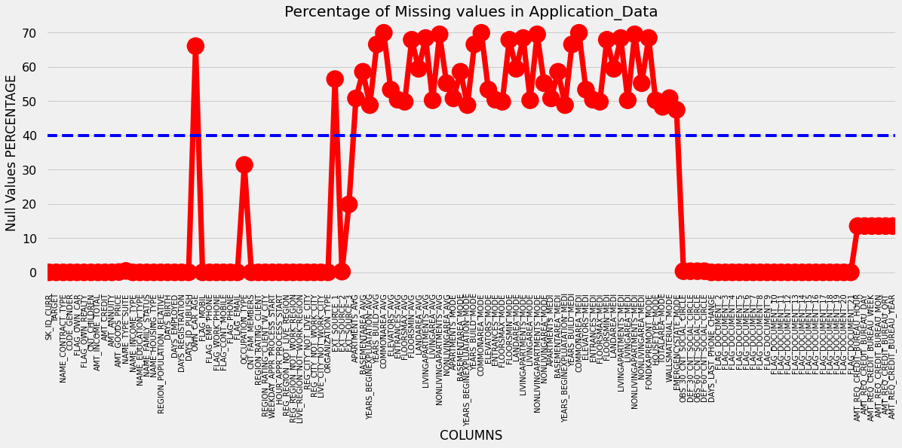

Slide 11

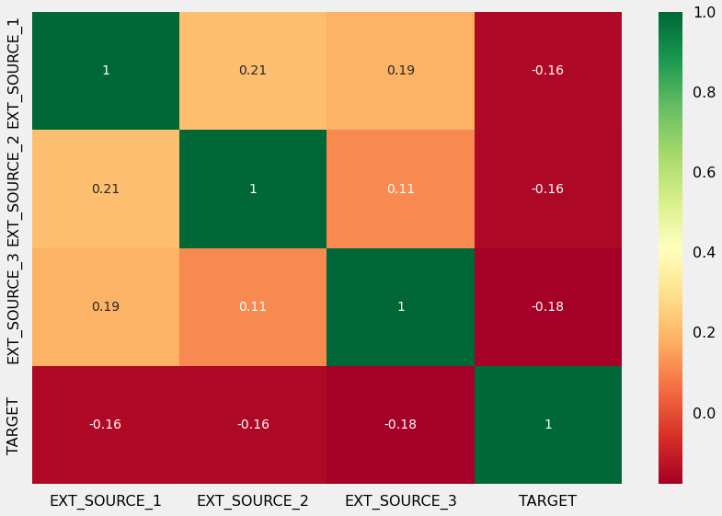
Analyse and Delete Unnecessary columns

Slide 12
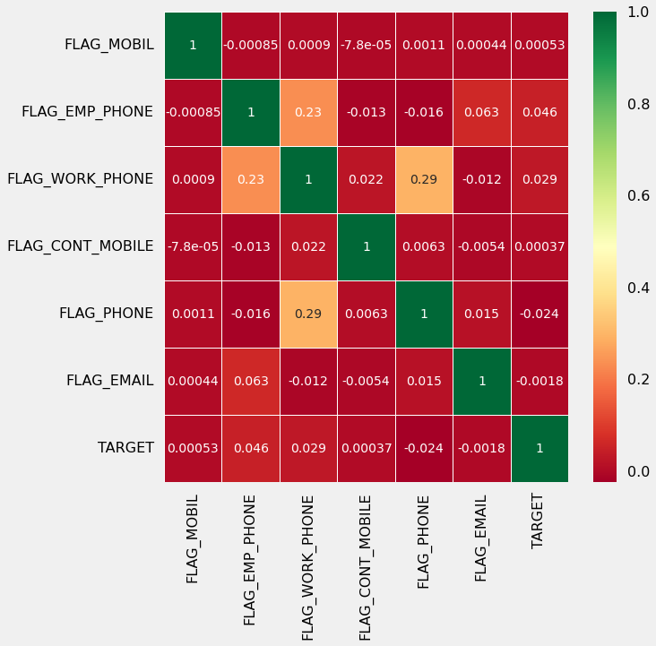
Correlation
Insights:
In previous slide: Based on the heatmap, we can say that EXT_SOURCE_1 has 56% null values, where as EXT_SOURCE_3 has to close to 20% null values
There is no correlation between flags of mobile, email etc with loan repayment thus these columns can be deleted.

Slide 13
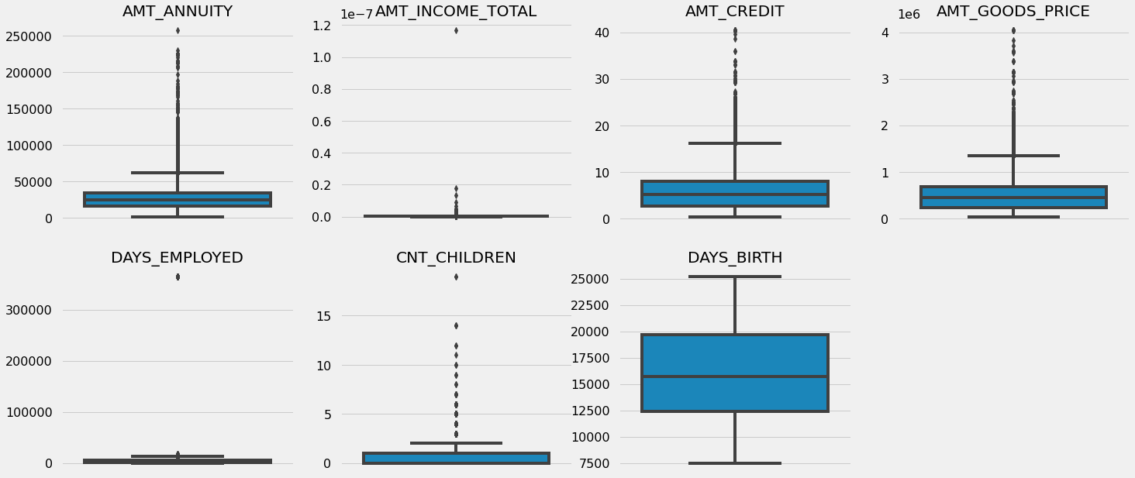
Outlier detection

Slide 14
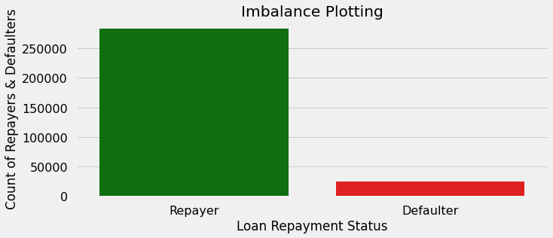
Data Analysis
Inference:
Contract type: revolving loans are just a small fraction (10%) from the total number of leans in the same time a larger amount of revolving loans, comparing with their frequency, are not repaid.

Slide 15
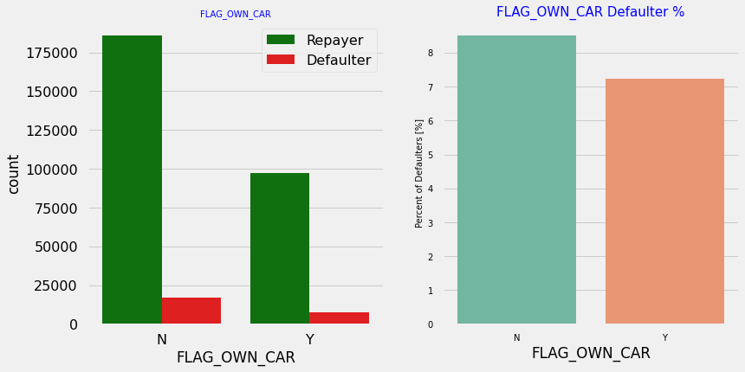
Categorical variable analysis
The number of female clients is almost double the number of male clients, based on the percentage of defaulted credits, males have a higher chance of not returning their loans (~10%), comparing with women (~7%)

Slide 16
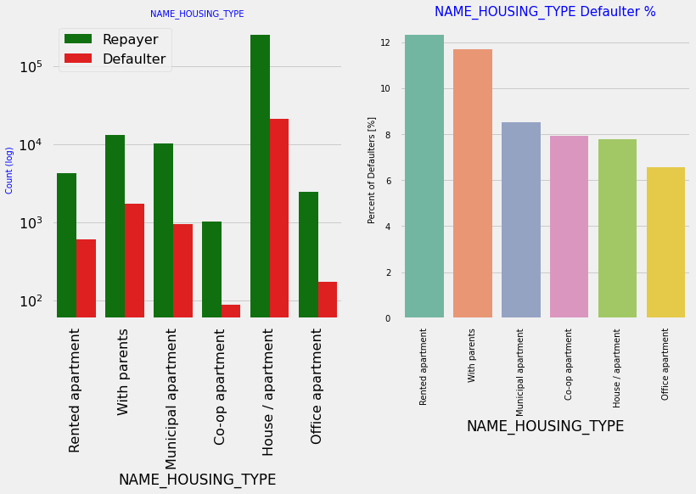
Viewpoints:
Majority of people live in House/Apartment , whereas people living in office apartments have lowest default rate while people living with parents (~11.5%) and living in rented apartments (>12%) have higher probability of defaulting

Slide 17
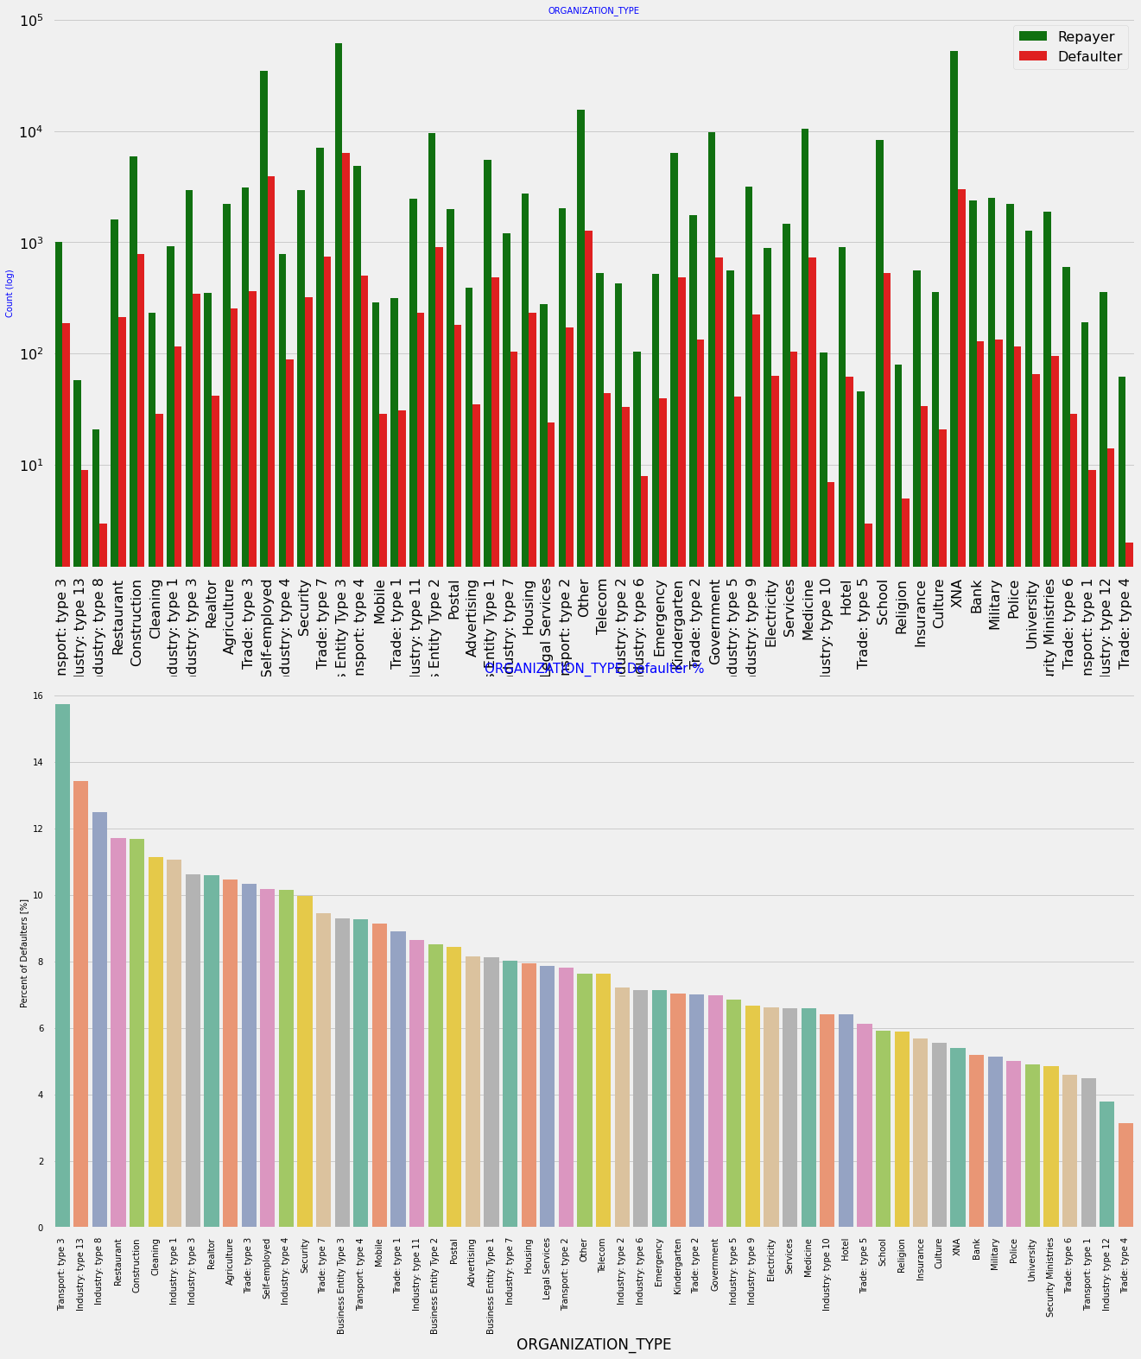
View Points:
The companies with the largest percentage of loans that have not been repaid fall into the following categories: Transport: type 3 (16%), Industry: type 13 (13.5%), Industry: type 8 (12.5%) and Restaurant (less than 12%). Self-employed individuals have a comparatively high default rate, so they should be avoided when applying for loans or given loans with higher interest rates to reduce the chance of default.
The majority of those that apply for loans are from Business Entity Type 3
Organisation type information is unavailable (XNA) for a very large number of applications.

Slide 18
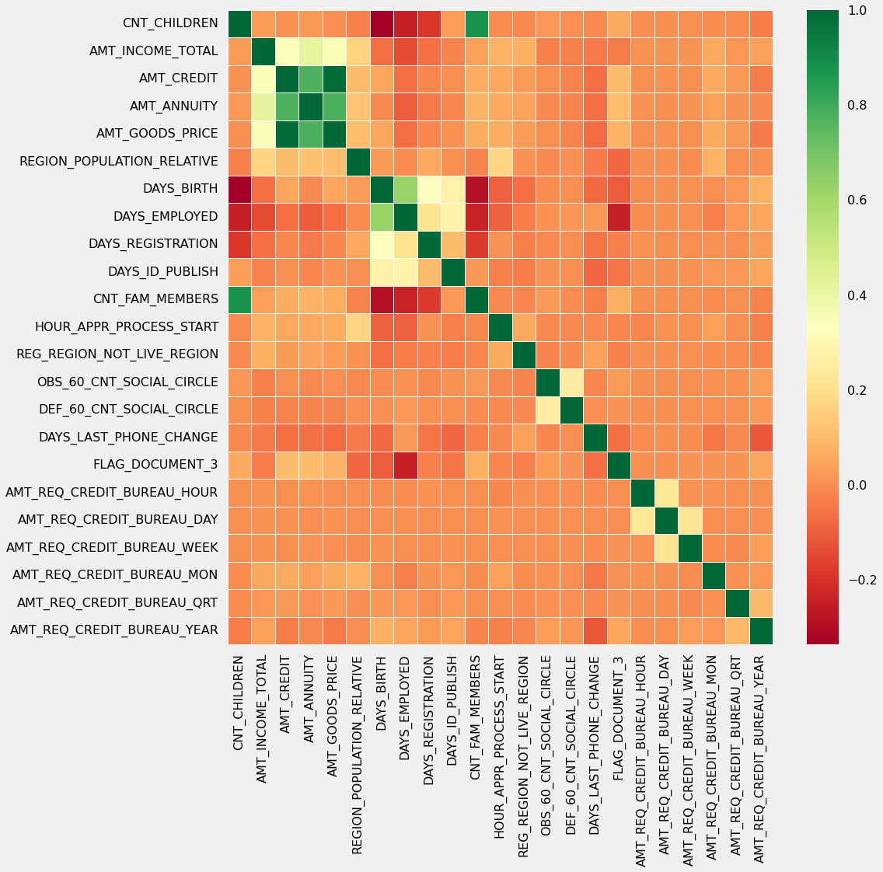
View points:
Correlating factors amongst repayers:
Credit amount is highly correlated with amount of goods price, loan annuity, total income
We can also see that repayers have high correlation in number of days employed.

Slide 19
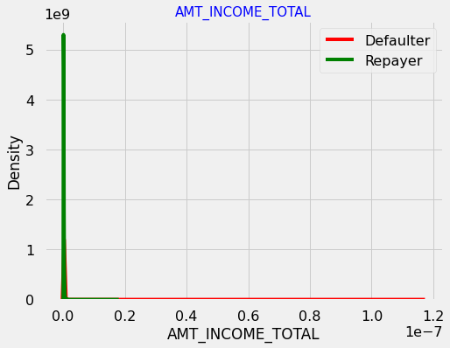
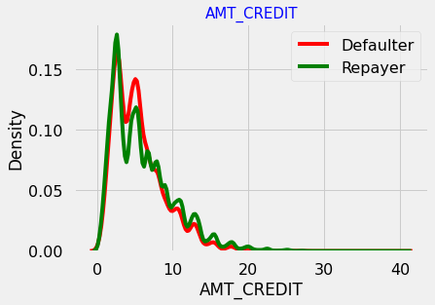
Numerical Univariate Analysis

Slide 20
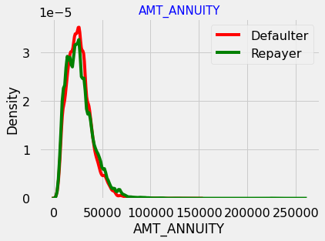
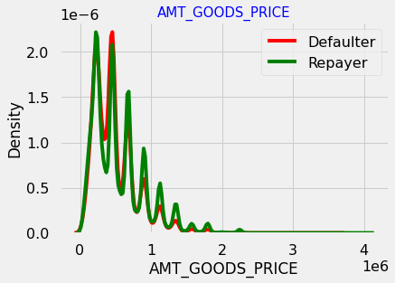
Numerical Univariate analysis

Slide 21
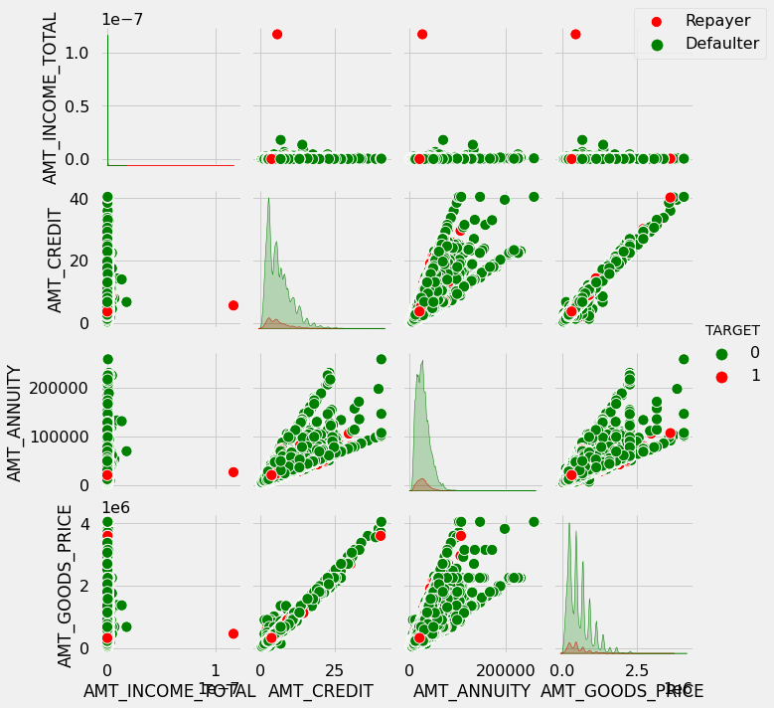
Pair plot
View points
When amy_annuinty is greater than 15000 amt_goods_price > 3M, there is a lesser chance of defaulters
AMT_CREDIT and AMT_GOODS_PRICE are highly correlated as based on the scatterplot where most of the data are consolidated in form of a line
There are very less defaulters for AMT_CREDIT > 3M

Slide 22
Suggestions
After analysing datasets, there are few attributes of a client with which the bank would be able to identify if they will repay the loan or not.
90% of the previously cancelled client have actually replayed the loan.Keep track of the cause so that the bank can later decide and negotiate conditions with those who are paying their debts in order to expand its commercial opportunities.
88% of the clients whose loan requests had previously been denied by the bank are now reimbursing clients. Documenting the cause for rejection could therefore help to reduce the company loss and allow for additional loan requests from these clients.

Slide 23
Thank You

